Slide 1


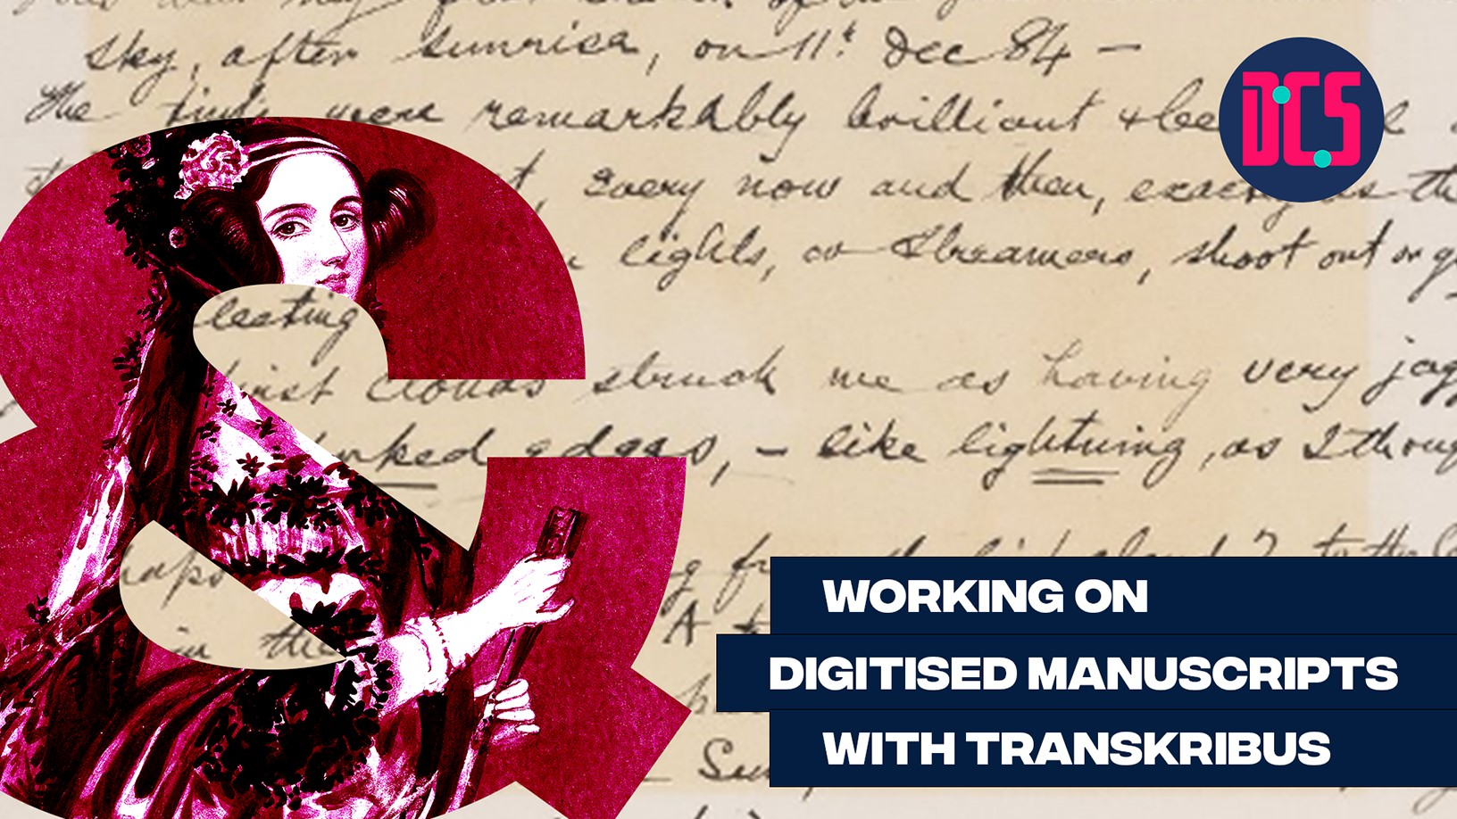
Using Transkribus
cdcs@ed.ac.uk

Slide 2



@EdCDCS
For all events, news, and support: cdcs.ed.ac.uk

Slide 3
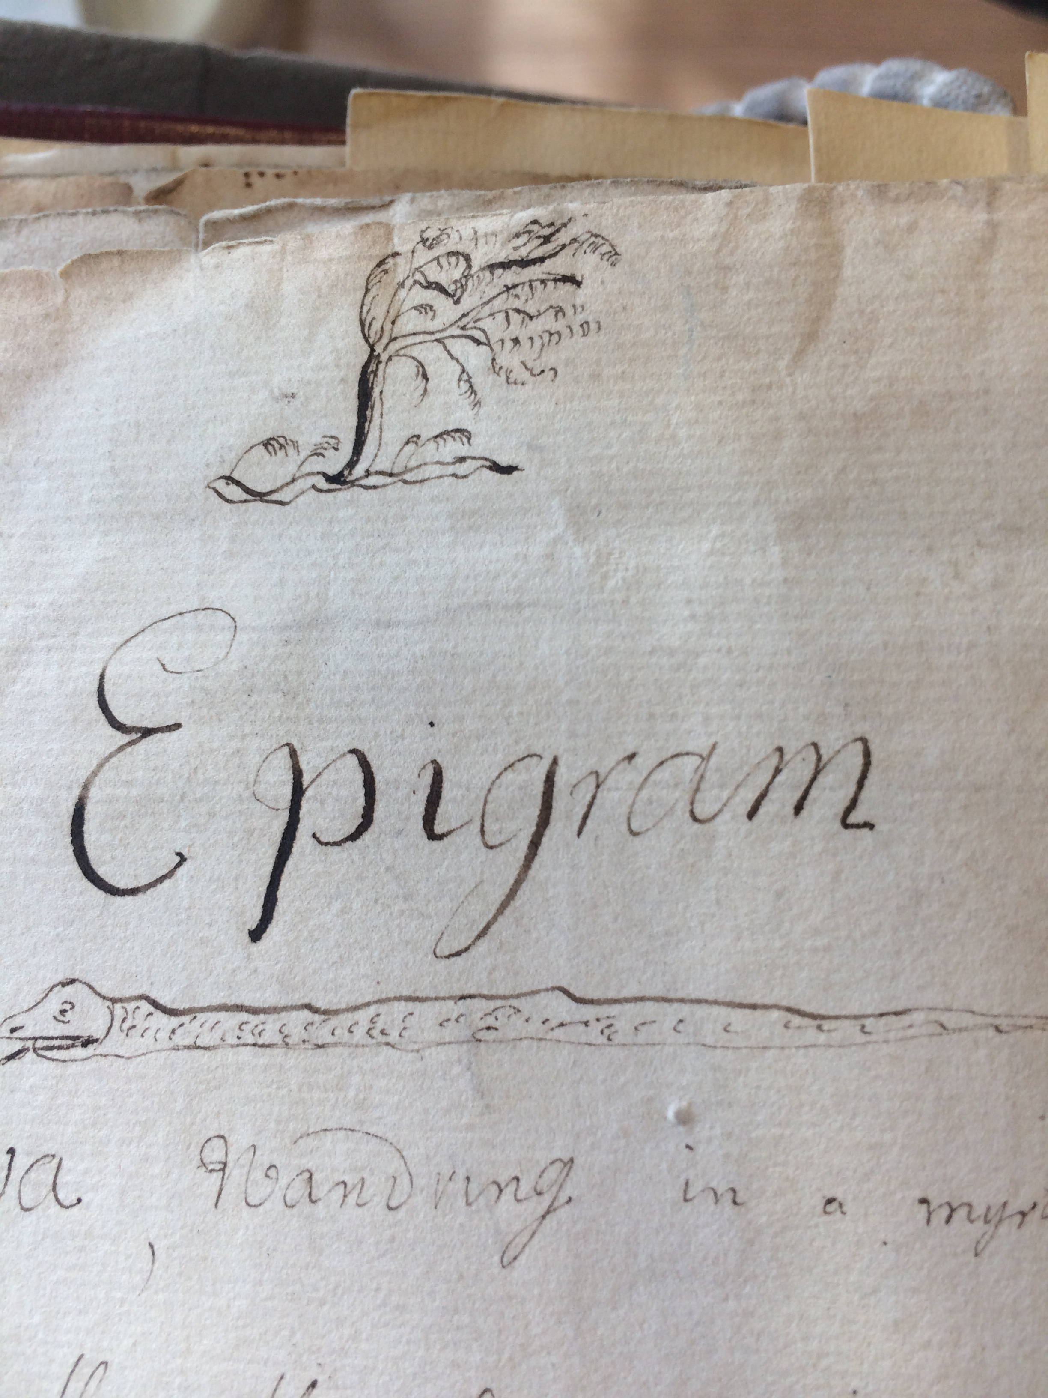
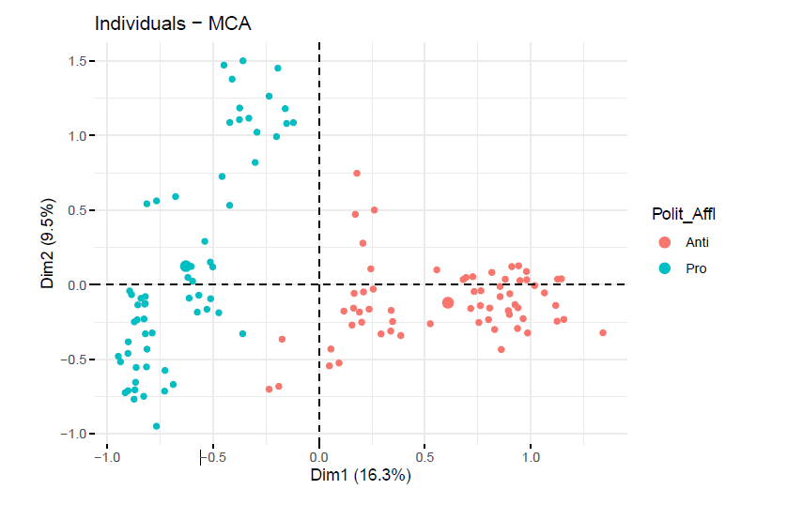

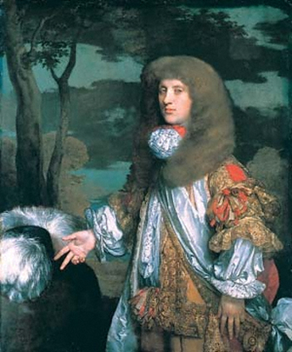

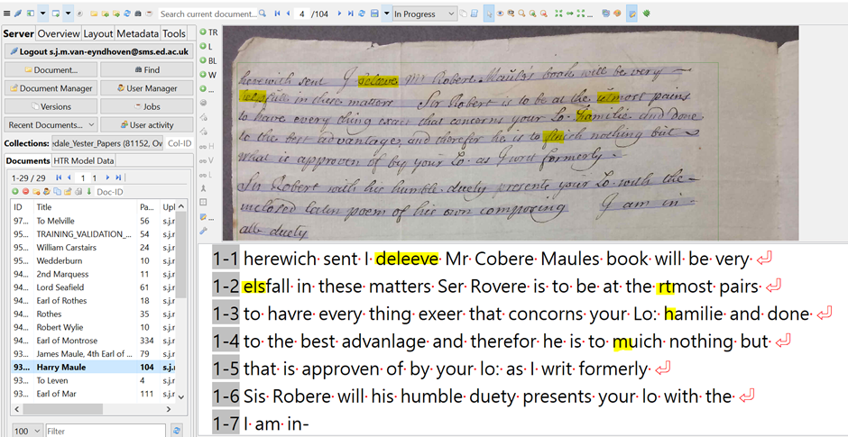
Before starting …
Who am I?
Sarah van Eyndhoven
PhD in Linguistics from UofEd
Digitising 18th c. letters
Training fellow with DCS
Credits: The material on these slides were taken from the Transkribus website: https://readcoop.eu/transkribus/resources/how-to-guides/

Slide 4

Today's program
HTR and OCR technologies
Uploading documents
Text zones and images
Segmentation and baselines
Distorted or broken text
Abbreviations, contractions, unusual characters
Manual Transcription
www.cdcs.ed.ac.uk

Slide 5


What is Transkribus?
Transkribus is an AI-powered platform for text recognition, transcription and searching of historical documents. This tool can be used to manually or automatically transcribe historical handwritten or printed documents. Currently, Transkribus has 100 000+ registered users, 15 000+ AI HTR models trained, 40+ million pages processed and 100+ free public AI models. It can be used in its basic format to manually transcribe letters, diaries etc, but it also has a powerful Handwritten Text Recognition (HTR) and Optical Character Recognition (OCR) functions, based off deep-learning neural networks. As all transcribed data is automatically uploaded to the server, the algorithm is continually learning and being improved by the community using it, creating a self-serving feedback loop.
www.cdcs.ed.ac.uk

Slide 6
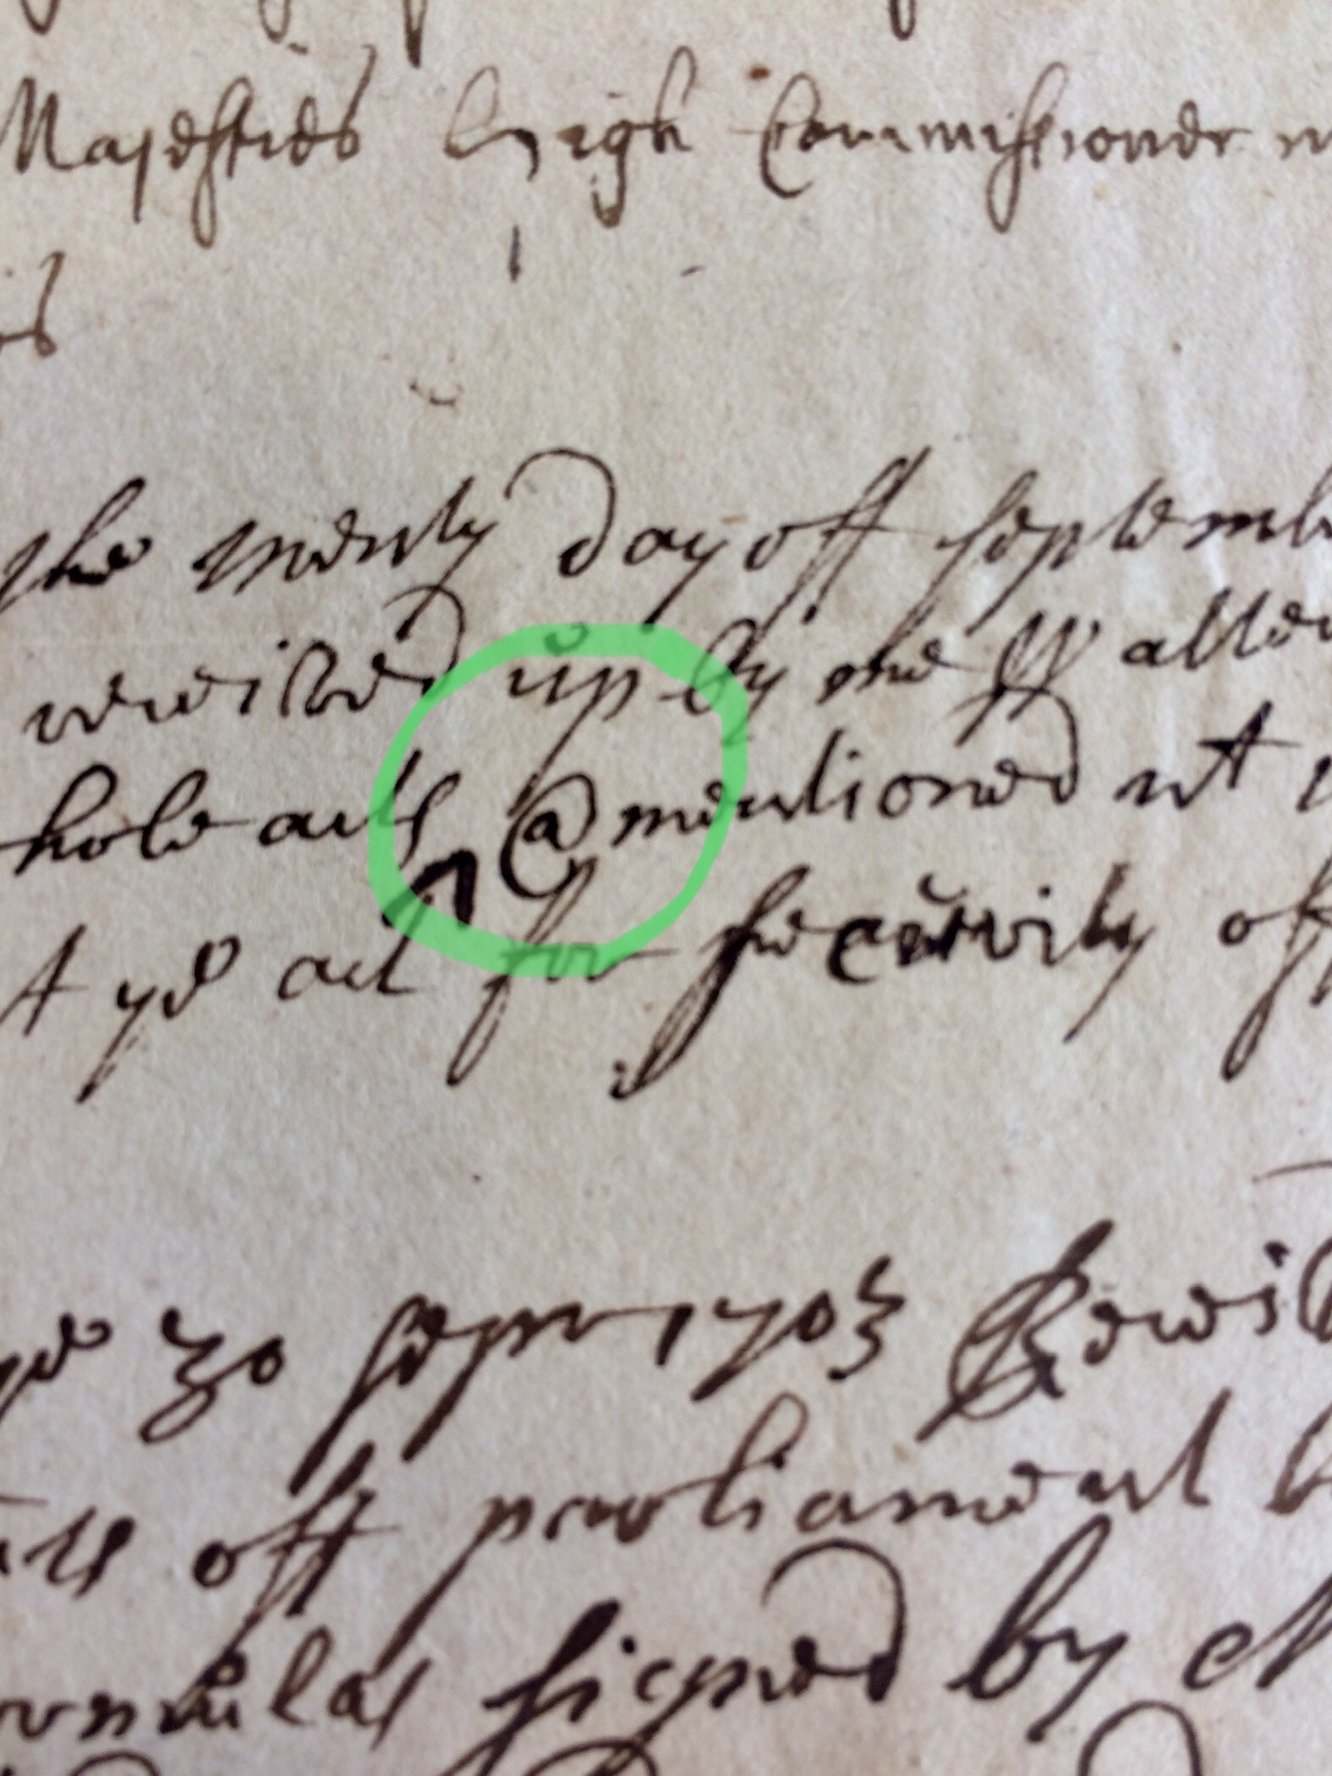
Why use automatic text recognition?
Save considerable time = Bigger and more ambitious projects
Explore new resources, bring new knowledge to light
Digitised transcriptions can be put online and made publically accessible = Democratise knowledge
To gain added information, e.g. decipher difficult words/characters
Production of faithful transcriptions
Save cost
www.cdcs.ed.ac.uk

Slide 7
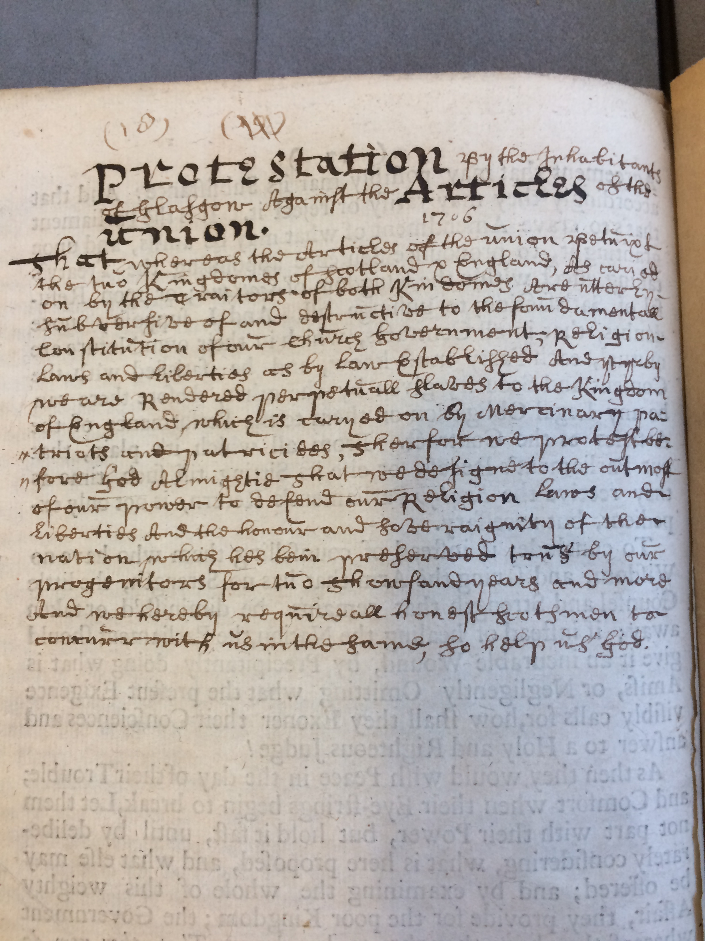
What is HTR?
HTR – Handwritten Text Recognition
Training a model to automatically process a collection of handwritten documents
Deep neural-network approach, using platform such as PyLaia
The model needs to be trained to recognise a certain style of writing by being shown images of documents and their accurate transcriptions
www.cdcs.ed.ac.uk

Slide 8
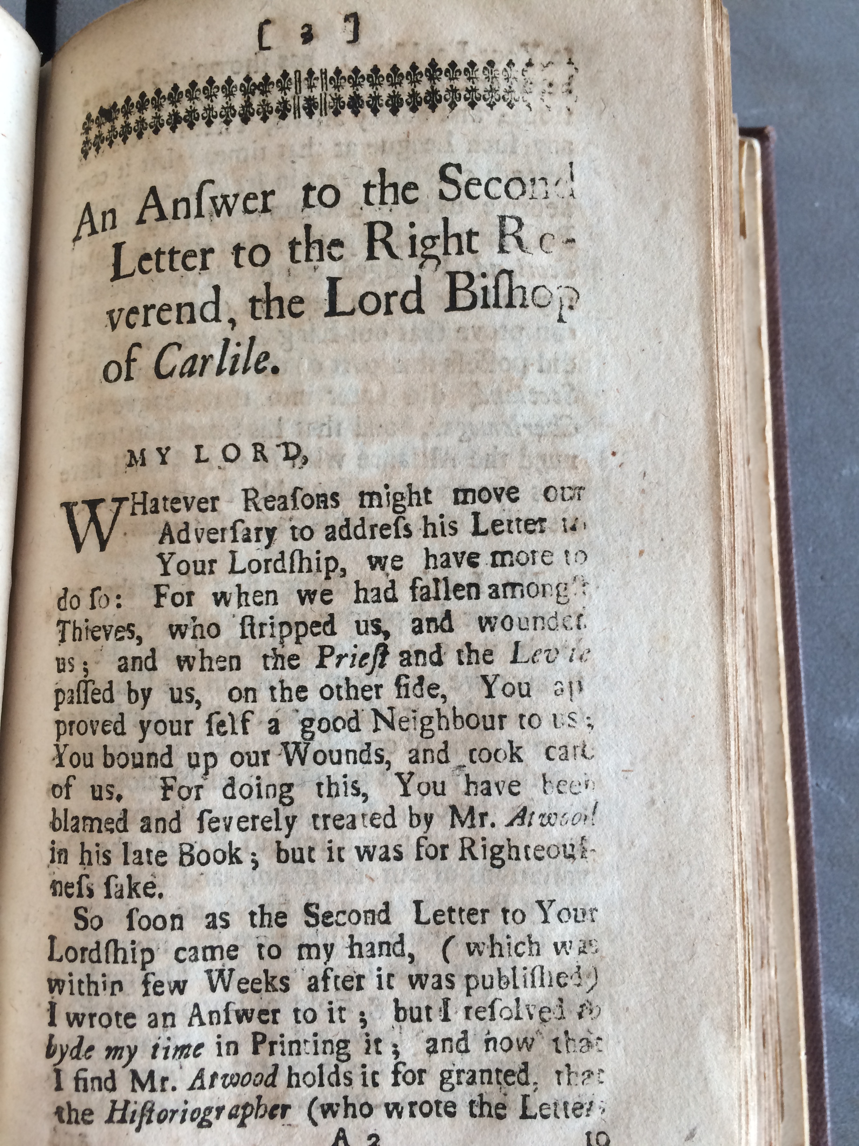
What is OCR?
Optical Character Recognition (OCR)
Works with printed material, i.e. historical newspapers, legal volumes, novels, etc
Recognises printed characters and produces text-searchable output
If you are working with printed rather than handwritten text, a smaller amount of training data is usually required
Today we will focus on HTR
www.cdcs.ed.ac.uk

Slide 9
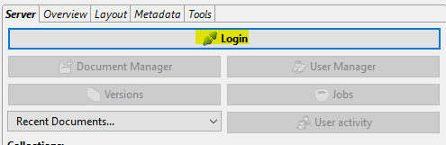
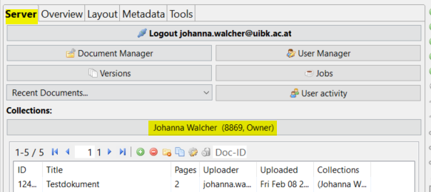
Uploading to Transkribus
You will have access to your private collection named after your email address. This collection includes some test documents that you can experiment with.
You can find it by clicking the “Collections” button in the “Server” tab.
Start Transkribus
Use the “Login” button in the “Server” tab
www.cdcs.ed.ac.uk

Slide 10

Uploading to Transkribus
Documents need to be uploaded to the server for automated processes (like HTR) to be performed
Must be PDF, JPEG, PNG and TIFF files. JP2 files are not supported
Click the “Import document(s)” button to transfer the images from your computer to the platform. Note: the images need to reside in a separate folder on your computer before you upload them to Transkribus!
Check out the DocScan app for Android smartphones to take images and upload them directly to Transkribus. For more information: https://scantent.cvl.tuwien.ac.at/en
www.cdcs.ed.ac.uk

Slide 11
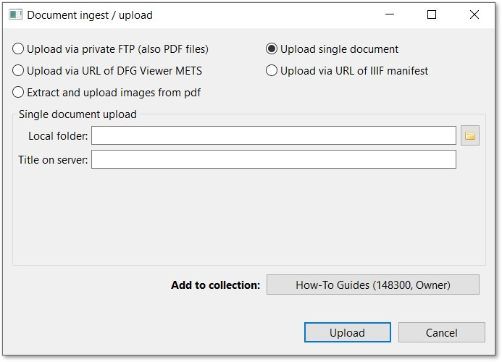
Uploading to Transkribus
Different upload options (PDF, single document, etc.). We will use ‘single document’
Give your folder a new name if you want
Click on folder icon to navigate to location on your device
You can add your documents to one of your existing collections or create a new one by clicking “Add to collection” and then clicking “Create”.
You can check the status of your upload by clicking on the little coffee cup icon
www.cdcs.ed.ac.uk

Slide 12
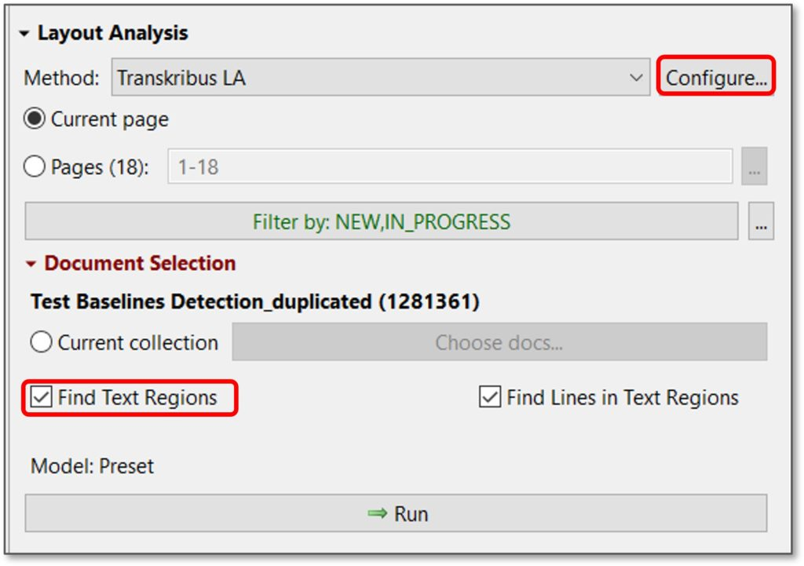
Text regionss
To feed the HTR engine with training data your documents need to be segmented into lines. This can be done automatically in Transkribus.
Detects and identifies regions of text on the page and lines
Can have multiple regions (i.e. header, footer, page number, marginalia, etc)
Underneath ‘tools’ tab
www.cdcs.ed.ac.uk

Slide 13
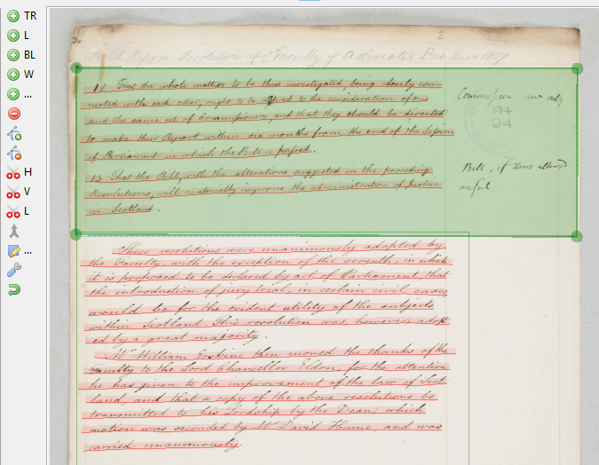
Correcting text regions
All tools for corrections on the layout analysis can be found in the “Canvas”-menu left of the image. You can check their functionality by hovering over icons
Sometimes, Transkribus fails to recognise text that should be included in the text area
Click inside the region so that it is highlighted and drag the border of the text region as needed
www.cdcs.ed.ac.uk

Slide 14
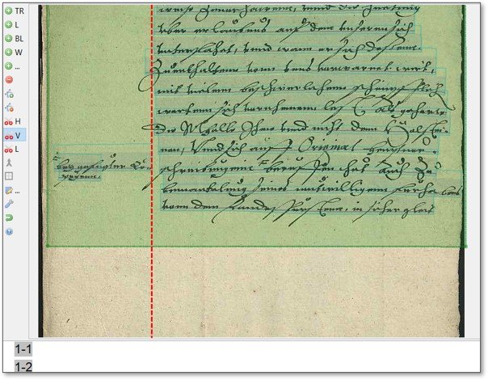
Correcting text regions
Other times, it includes areas of text that you might want to keep separate, or exclude altogether (i.e. marginalia)
The “H-button” splits a text region horizontally
The “V” button splits a text region vertically
The “L-button” allows you to split a text region with a customisable line
Remember always first to select the text region you want to split
www.cdcs.ed.ac.uk

Slide 15
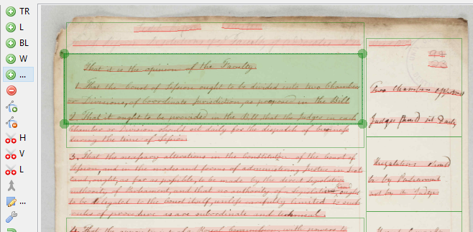
Correcting text regions
Sometimes you don’t want a region at all depending on your research needs (i.e. like the page number or archival notes), or two regions overlap, so one can be deleted
To delete, click on the text region you wish to delete, and click the red “Remove a shape” button
www.cdcs.ed.ac.uk

Slide 16
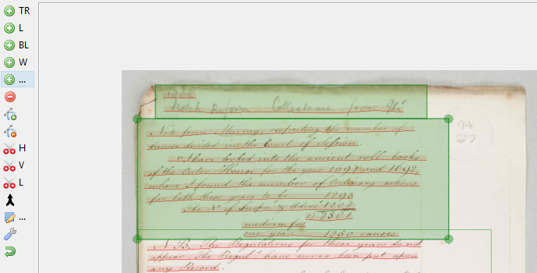
Correcting text regions
Sometimes the program creates two text regions where only one is needed
In this case, you can easily merge the two together. Hold down the “CTRL” button on your keyboard and click on both text regions
Click the “Merge the selected shapes” button in the Canvas menu
www.cdcs.ed.ac.uk

Slide 17
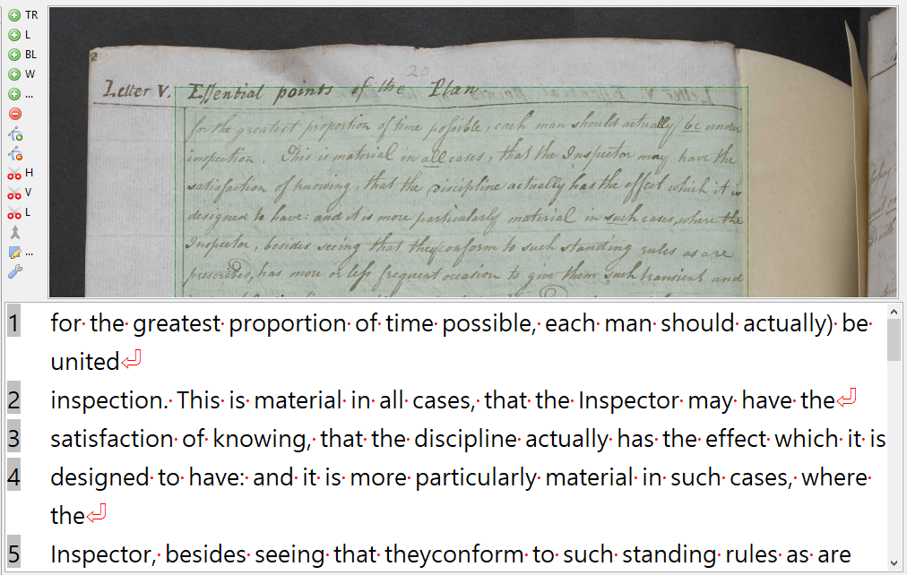
Baselines
These are the lines of text in your document, automatically detected simultaneously with the text regions
If you are training a HTR model, the text regions do not need to be corrected, and the reading order of the text is not relevant
What is important is that the characters of the line rest upon the baseline and the descenders extend below and that there is a correspondence between the line in the image and the transcribed line
If you are manually transcribing however, then you will want to correct disfluencies
www.cdcs.ed.ac.uk

Slide 18
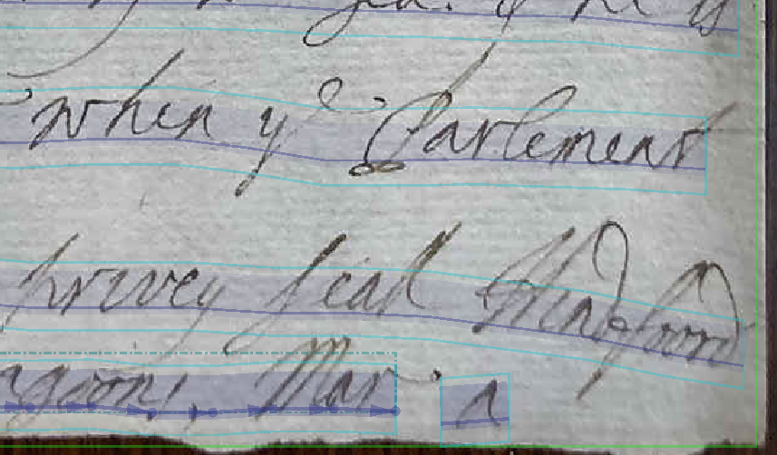

Distorted text
For each line/baseline in the image, you will find a corresponding line in the Text Editor. The image and the text are thus connected
You therefore want to connect any broken lines that may have been distorted
The process is the exact same as text regions: use CTRL to select both pieces of the baseline, then “merge selected shapes” to connect them
www.cdcs.ed.ac.uk

Slide 19
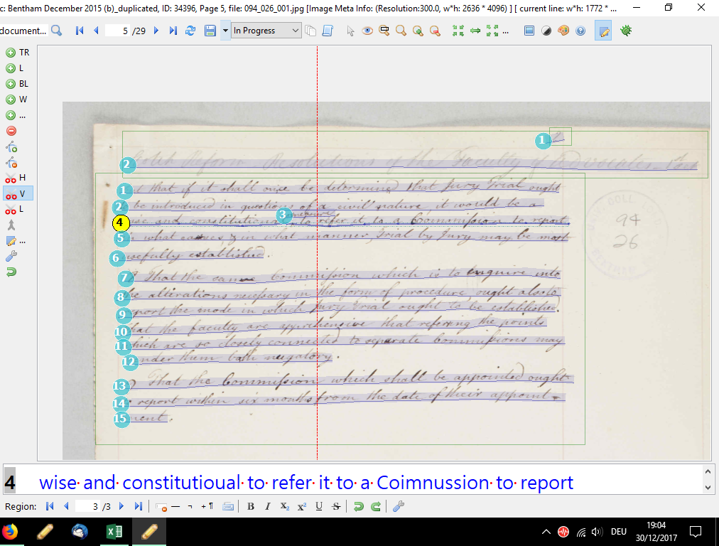
Additional text
On the flip side, you may have to break up baselines in order to get the correct reading order
Interline additions are a frequent way in which text is added to a document
In order to generate the correct reading order, select the baseline below the addition (if the addition is above the line).
Split the line region with the “V” button in the Canvas menu exactly where the addition should be logically placed
Additions which appear as extra notes (e.g. at the margins of a page) should be handled in a similar way to interline additions
www.cdcs.ed.ac.uk

Slide 20
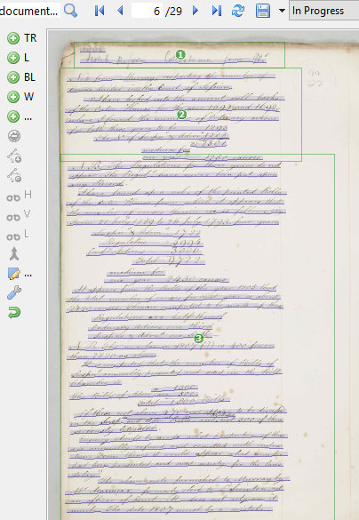
Reading order
You may need to think about the reading order of the text
Many handwritten documents include corrections and additions added by the author or someone else. In a scholarly edition, you want to keep the reading order and maybe also express the fact that this text was an addition
For this purpose, all segmentation elements can be ordered according to a user-defined order
The default reading order follows the topology of the text or line regions. All shapes are ordered according to the coordinates of the top left corner of a text or line region
www.cdcs.ed.ac.uk

Slide 21
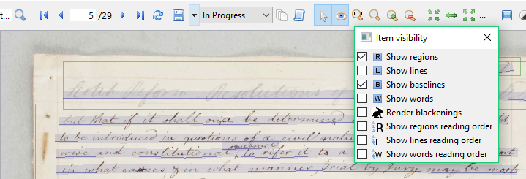
Reading order
This mechanical reading order can be changed: click on the “Item visibility” button in the Main menu, and you can then choose to show the reading order of text regions, lines, baselines (or words)
www.cdcs.ed.ac.uk

Slide 22
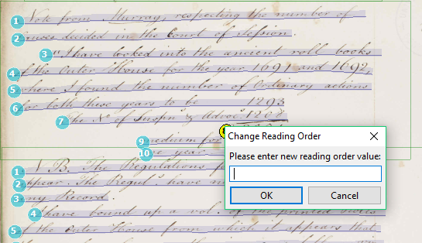
Reading order
Once you choose to show the reading order of text regions or lines, numbers will be displayed on the image of your document
By clicking on one of the numbers marking the reading order, it is possible to type in a new number and change the reading order accordingly
If you have interline additions and need to add in extra baselines, you can edit the reading order so that it is correct. Click on the number associated with each baseline and then type the correct one.
Additions which appear as extra notes (e.g. at the margins of a page) should be handled in a similar way to interline additions
www.cdcs.ed.ac.uk

Slide 23
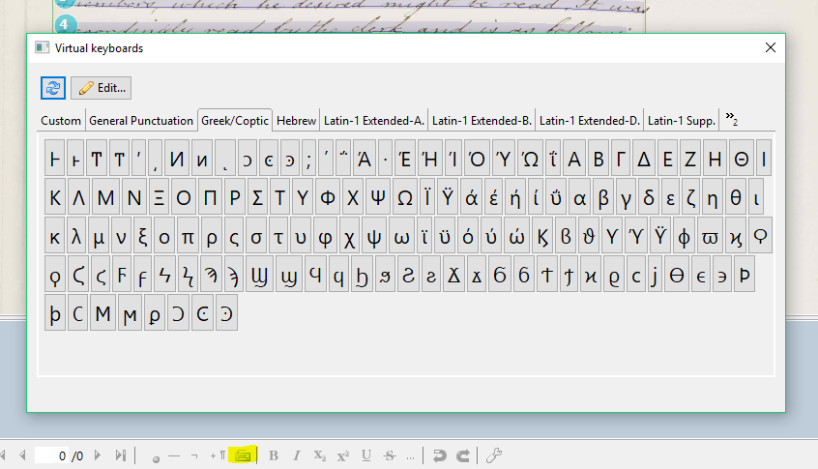
Abbreviations, Characters, Etc.
You can add special characters and Unicode symbols using the “Virtual keyboards” button in the Text Editor field
With the “Edit…” button, it is possible to add shortcuts for frequently used characters and to add new Unicode characters.
To create a shortcut, you just need to type it in the “Shortcut” column. To add new Unicode characters, you use the green plus button
www.cdcs.ed.ac.uk

Slide 24
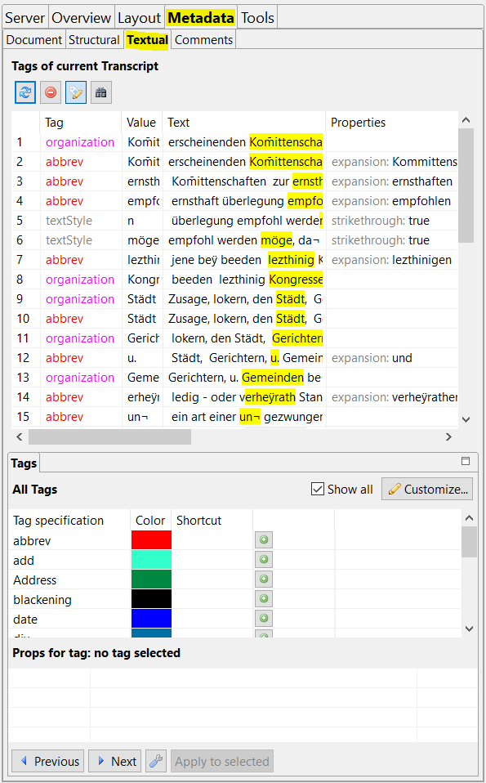
Tagging
The tagging interface can be found by clicking the “Metadata” tab, and then the “Textual” tab
If you put a tick at “Show all” at the bottom of the “Textual” tab, all the predefined tags will be shown. You can start working with these right away.
To create your own tag categories, click the “Customize” button in the “Tags” tab. The “Tag configuration” window will open up
With the “Create new tag” button you can add your own tags
Once you have created a new tag, it will appear when you click the “Show all” button.
www.cdcs.ed.ac.uk

Slide 25
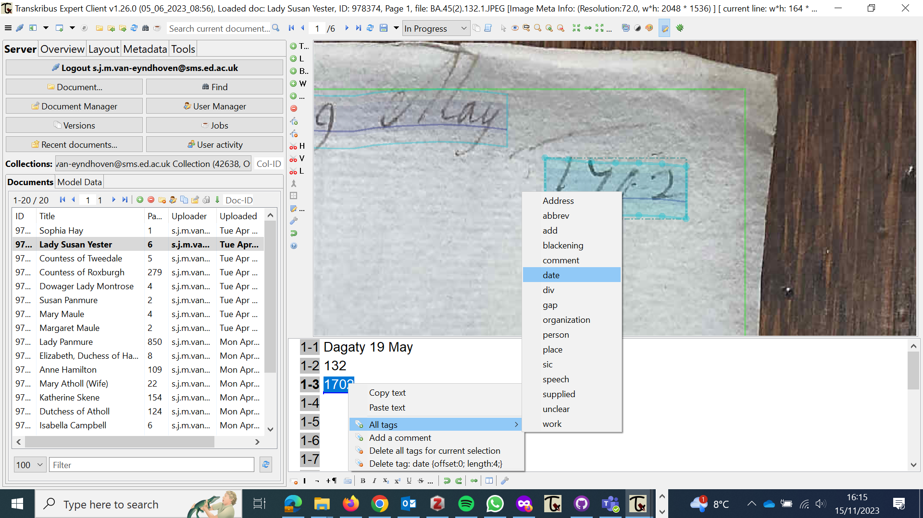
Tagging
To tag words in text, highlight the word or phrase and then make a right click with your mouse. Under “All tags” the suitable one can then be chosen
If there are tag categories you use frequently, you can create a shortcut for them in order to speed up your work. To do so, within the “Textual” tab, click the “Customize” button in the “Tags” tab. In the “Tag Specifications” section, you can now add your preferred shortcut in the “Shortcut” column.
www.cdcs.ed.ac.uk

Slide 26
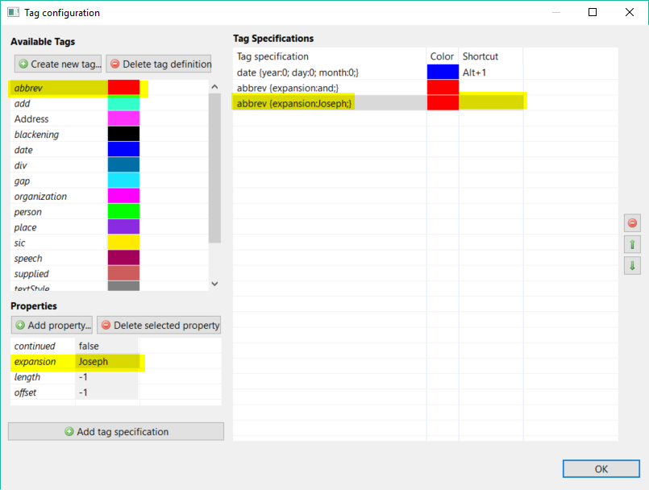
Tagging
You can also add a shortcut relating to the properties of your tags, e.g. for expanding abbreviations or adding a standardised country name to a place tag.
Click the “Customize” button in the “Tags” tab.
In the “Tag configuration” window click the desired tag. The details relating to that tag will appear in the “Properties” section.
Click “Add property” to add the property you would like.
Then click “Add tag specification”
Now your tag and its property (e.g. an expansion for an abbreviation) will appear in the “Tag Specification” section
Add the shortcut you would like to use.
Now you can add the tag and its property by simply highlighting the word or phrase in the Text Editor field and then pressing the short cut.
www.cdcs.ed.ac.uk

Slide 27
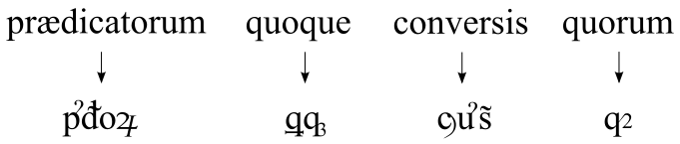
Abbreviations
You can either:
Expand abbreviations in the usual way. Neural networks are often able to learn to recognise and reproduce expansions. E.g. Latin prefixes and suffices such as “cum”, “con” or “us” and “orum” are learned easily.
If you are interested in using Unicode characters which are near to the special graphemes of the original document, then you can transcribe the text by utilizing the full power of Unicode.
If you can recognize the base character – transcribe the base character. This rule is especially suited to historians and people interested in the “content” of a document and those who want to provide training data for the HTR engine.
Note: When it comes to HTR training, tags are not relevant yet. Developments in Named Entity Recognition technology should make the automated recognition of tags possible in the future
www.cdcs.ed.ac.uk

Slide 28
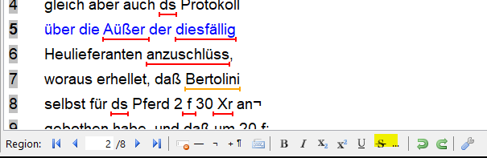
Illegible, Deleted text, etc
Text which cannot be transcribed since it is illegible can be marked with the tags “unclear” or “gap”.
If text is impossible to read, click your cursor where the
text appears in the text editor field and add the “gap”
tag
If text which is deleted is still readable, or at least large portions are readable, transcribe the text as well as possible and mark it as strike through. You can find the “strike through” button in the Text Editor menu.
www.cdcs.ed.ac.uk

Slide 29
Now it’s your turn!
Have a go at transcribing some of the text!
This is an eighteenth century letter written by the Duchess of Atholl – so do not worry if you find it challenging at first
Call me over if you get stuck ☺
Happy transcribing!
www.cdcs.ed.ac.uk

Slide 30
Today's program
Train and run an HTR model
Character Error Rate (CER)
How to use your model
How to build upon your model
Exporting formats
Keyword spotting
www.cdcs.ed.ac.uk

Slide 31
An overview
Any HTR model needs to be trained to recognise a certain style of writing by being shown images of documents and their accurate transcriptions.
For the training of a model between 5,000 and 15,000 words (around 25-75 pages) of transcribed material are required.
If you are working with printed rather than handwritten text, a smaller amount of training data is usually required.
If you are working with multiple hands (scribes/authors/writers) more data will be needed, with a portion from each hand included
With the use of a base model the amount of required training data can be reduced. As base model you can either use one of the publicly available models in Transkribus, if there is a suitable one for your documents or one of your own models, which you have already trained before.
An overview of the currently available public models you can find on the Transkribus website:
https://readcoop.eu/transkribus/public-models/
www.cdcs.ed.ac.uk

Slide 32
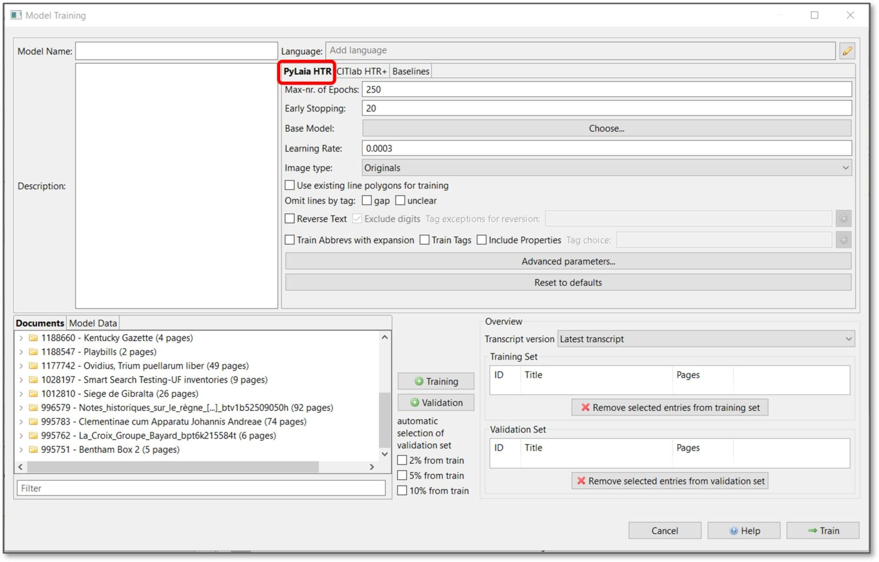
Table of Contexts
You can create training data for HTR in Transkribus by uploading images and transcribing text. Once this is done, you are ready to train a model.
Click on the “Tools” tab. Under the “Model Training” section, click on “Train a new model”.
By default, “PyLaia HTR” is selected.
In the upper section, you need to add details about your model:
Model Name (chosen by you)
Language (of your documents)
Description (of your model and the documents on which it is trained)
www.cdcs.ed.ac.uk

Slide 33
Parameters for PyLaia: what do they mean?
Max-nr. of Epochs
Refers to the number of times that the training data is evaluated.
You can increase the maximum number of epochs, but be aware that the training process will take longer.
Furthermore, the training will be stopped automatically when the model no longer improves (i.e. it has reached the lowest possible Character Error Rate).
For a start, it makes sense to stick to the default setting of 250.
Early Stopping
The value of 20 means that if, after 20 epochs, the CER of the Validation Set does not go down, the training will be stopped.
… and more
In general, you can go with the defaults
For advanced settings or to learn more, check the Transkribus documentation: https://readcoop.eu/transkribus/howto/how-to-train-a-handwritten-text-recognition-model-in-transkribus/#h-training
Base model
It is possible to add a base model to your training.
More on this on the next slide
www.cdcs.ed.ac.uk

Slide 34
Base Model
It is possible to add a base model to your training, which has a number of benefits:
The neural nets will learn quicker and you will save time = can speed up the training process
The quality of your recognition results will also likely improve (but not guaranteed)
Makes it possible to start with a smaller amount of training pages, which means that the transcription workload is reduced.
The base model needs to be similar to the writing it should recognise.
You simply need to choose the desired one with the “Choose…” button next to “Base Model” in the training window
You can select one of the PyLaia public models or a PyLaia model of your’s.
www.cdcs.ed.ac.uk

Slide 35
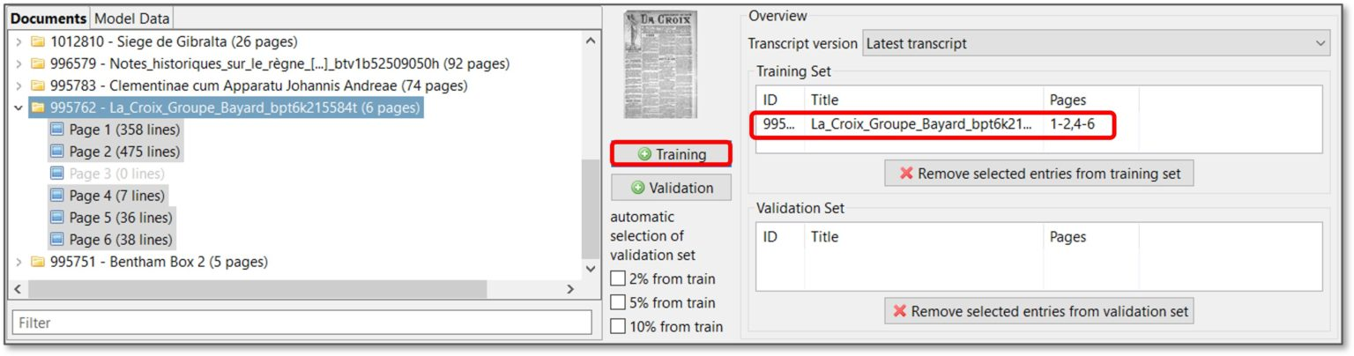
Training Set
To begin training, you need to select the pages that you would like to be included in your set of training data. The documents you have loaded in Transkribus should appear under ‘documents’ in the training window
To add all the pages of your document to the Training Set, click on the folder and click “+Training”.
To add a specific sequence of pages from your document to the Training set, double-click on the folder, and select pages using “Shift” key. Then click “+Training”.
To add individual pages from your document to the Training Set, double-click on the folder, and select pages using “CTRL” key. Then click “+Training”.
The pages you have selected will appear in the “Training Set” space.
www.cdcs.ed.ac.uk

Slide 36
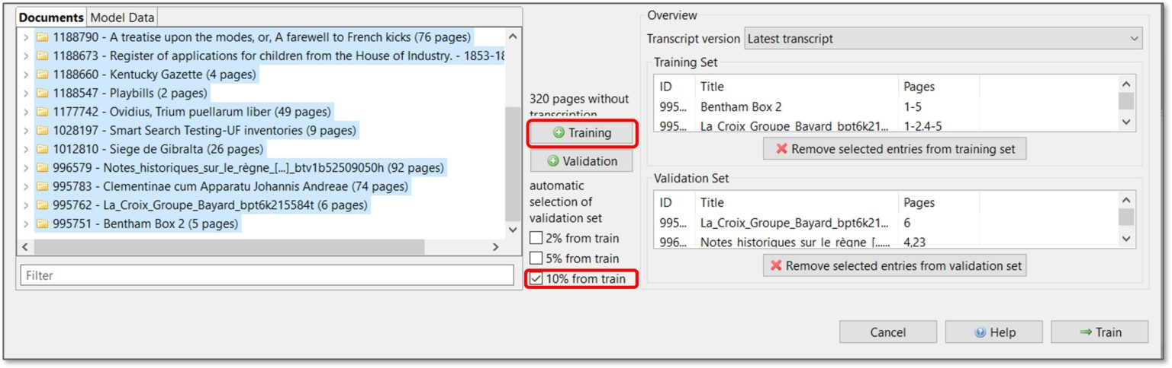
Validation Set
During the training process, a Validation Set of pages is set aside and is not used to train the HTR. These test pages will then be used to assess the accuracy of your model.
It is recommended that your Validation Set is about 10% of the Training Set. The pages in your Validation Set should be representative of the documents in your collection and comprise all the examples.
To add pages to the Validation Set, follow the same process as above but click the “+Validation” button.
You can also automatically assign 2%, 5% or 10% of the Training Set to the Validation Set. Select the pages to add to the Training Set, flag the percentage you want to assign to the Validation Set and click the “+Training” button.
www.cdcs.ed.ac.uk

Slide 37
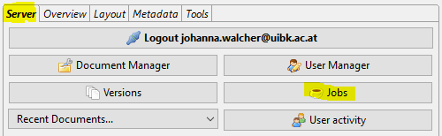
Training
To remove pages from the “Training Set” or “Validation Set”, click on the page and then click the red cross button.
Then, start the training by clicking the “Train” button.
You can follow the progress of the training by clicking the “Jobs”
(coffee cup) button in the “Server” tab.
You will receive an email when the training process is completed.
Training a Text Recognition model takes from some hours to several days, depending on the server traffic.
You can perform other jobs in Transkribus or close the platform during the training process. If the Job status is “created” or “running”, please don’t start a new training, but just be patient and wait.
www.cdcs.ed.ac.uk
Notes:
In the “Jobs” window, you can check your position in the queue (i.e. the number of trainings ahead of yours).

Slide 38
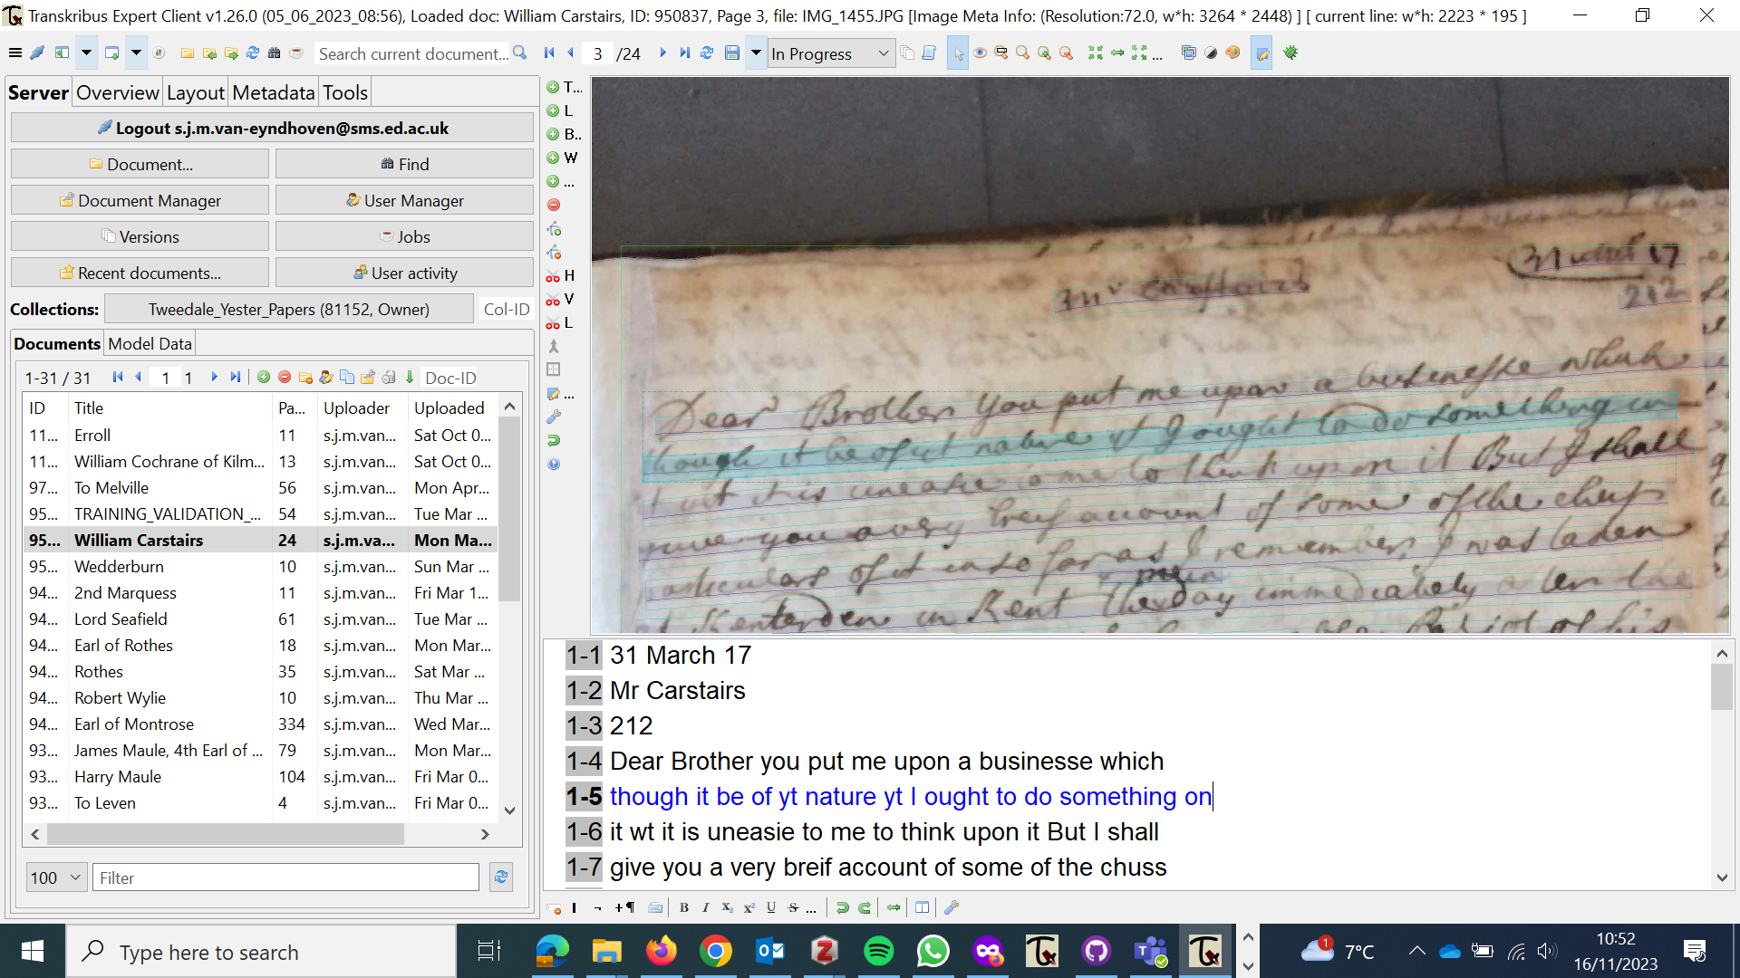
After the training
After your model is finished, you will get an email letting you know
When you log into Transkribus and select your collection, you will now see the pages of your document with text in the Text Editor field underneath
www.cdcs.ed.ac.uk

Slide 39
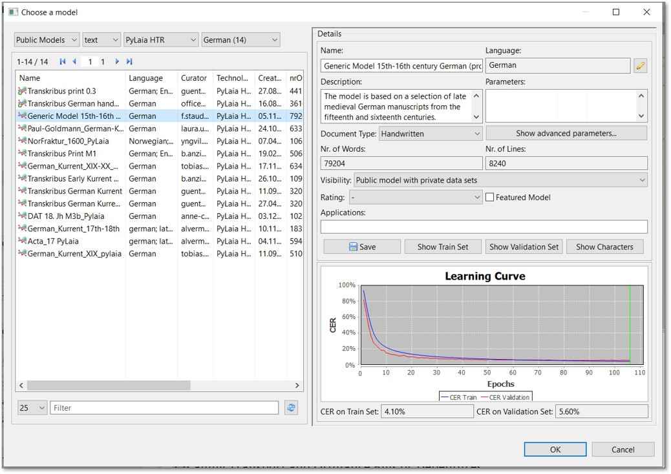
After the training
After your model is finished, it will be available in your collection. In order to access it, click the “View models” button in the “Tools” tab.
The following window will open up, where you can see all the public models and the models you trained:
www.cdcs.ed.ac.uk

Slide 40
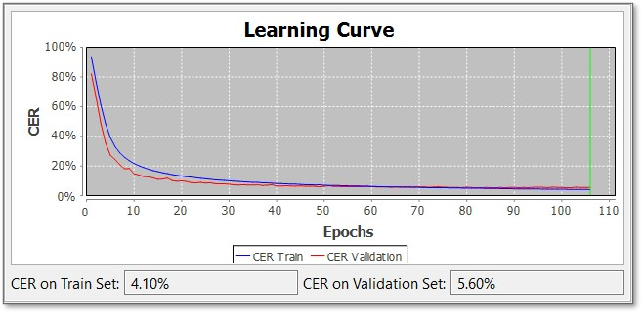
The learning curve
The “Learning Curve” graph signifies the accuracy of your model.
First the program trains itself on the Training Set, then it will test itself on pages in the Validation Set.
The graph shows two lines, one in blue and one in red.
The blue line represents the progress of the training.
The red line represents the progress of evaluations on the Validation Set.
www.cdcs.ed.ac.uk

Slide 41
The learning curve
“CER” or Character Error Rate, indicates the percentage of characters that have been transcribed incorrectly by the HTR model.
“Accuracy in CER” is indicated as a percentage on the y-axis. The curve will always start at 100% and will go down as the training progresses, and the model improves (i.e. lower error rate)
The x-axis is defined as “Epochs”. During the training process, Transkribus will make an evaluation after every epoch.
www.cdcs.ed.ac.uk

Slide 42
Statistics
Underneath the graph, two percentage values are shown relating to the CER for the Training Set and the Validation Set.
In Figure 10, the model performs with a 4.10% CER on the Training Set and 5.60% on the Validation Set.
The value for the Validation Set is the most significant as it shows how the Text Model performs on pages that it has not been trained on.
www.cdcs.ed.ac.uk

Slide 43
Character Error Rate
Results with a CER of 10% or below can be seen as very efficient for automated transcription.
Results with a CER of 20-30% are sufficient to work with powerful searching tools like Smart Search or Keyword Spotting
Remember: historical documents can be tricky! Ultimately, CER’s will be different for each collection
You have to decide whether the CER is worth going forward and automating the process or whether other options are better
These can include:
Manually correcting the output
Providing more training data and re-running the model (including manually corrected transcripts)
Adding a base model (if you haven’t already)
Abandoning HTR and manually transcribing everything
www.cdcs.ed.ac.uk

Slide 44

Using your model
Now that you have your model, you can use it to automatically generate transcripts of the documents in your collection.
To access your model:
Click on the “Tools” tab
Go to the “Text Recognition” section.
Click “Run”, then click “Choose HTR-model”.
Click on “Select HTR model” to choose your HTR model from the list of available models (your models plus the public ones)
Click OK.
Select whether you wish to generate a HTR transcript of one page or several pages.
Press “Run” to start the text recognition process.
Once the recognition is finished, the automated transcription will appear in the text editor field.
www.cdcs.ed.ac.uk

Slide 45
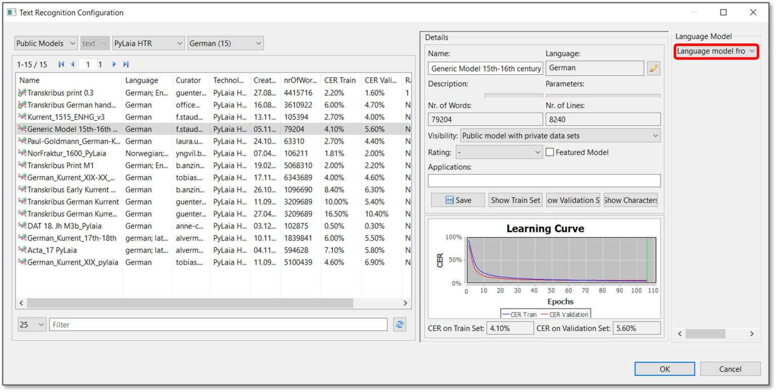
Language models
To re-train your model, follow the same instructions as training the model the first time round, but add your own model as the ‘base model’, plus additional training material
Language models are created automatically during the HTR-model training and can also be added to the recognition process.
These differ per individual case: in many cases, they are able to improve the recognition, but sometimes they don’t.
When selecting the HTR model, you can find the language model option top right. Click on the drop-down menu and choose “Language model from training data”.
www.cdcs.ed.ac.uk

Slide 46
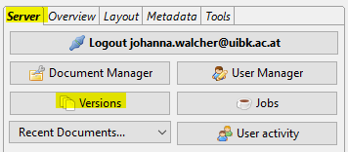
Save and export your transcription
Press the “Save” button in the Main Menu to save the document in Transkribus.
If you click on the “Versions” button in the “Server” tab, you will see that a new version has been created. This means that you can always access previous versions of a document should you need to.
www.cdcs.ed.ac.uk

Slide 47
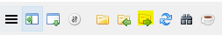
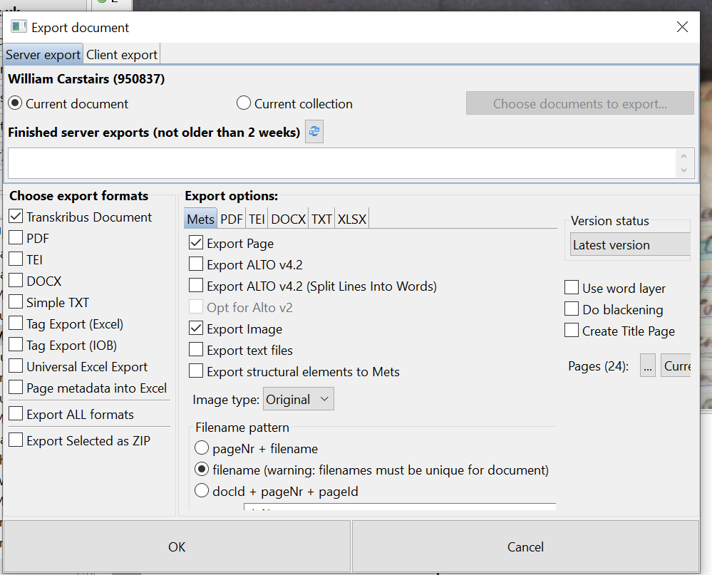
Exporting
You can export the whole document at any point of the process by
clicking “Export document”
There are two tabs offering Client export and Server export.
If you choose the Server export option, the export will be processed on the Transkribus server and you will receive a link to download your files. The export will not slow your computer down and the process will not be interrupted if you switch your computer off
After the process has finished you will receive an email with the link to download the files. If you wish to pass the files onto someone else, you can forward the email to them.
With Client export the files will be saved directly to your computer.
www.cdcs.ed.ac.uk

Slide 48
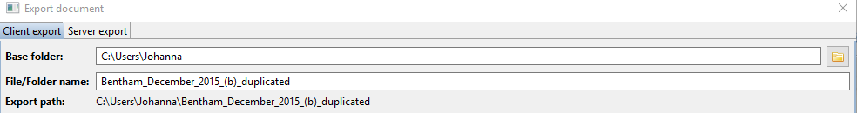
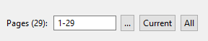
Exporting
With Client export you need to specify where to save the files
You do this by navigating to the right place on your device, or typing in the file path manually
Give the file or folder a name
Select the number of pages you wish to export. You can export all the pages in your document, or just the current page.
www.cdcs.ed.ac.uk

Slide 49
Exporting
There are also numerous export formats and options in Transkribus
The format you choose will depend on what you want to do next, e.g.
Build an online corpus of digital transcripts
Personal analysis
Utilise further text-analysis tools (such as AntConc)
Text-querying using programming tools
Etc…
www.cdcs.ed.ac.uk

Slide 50
Exporting
Transkribus Document
Produces a METS (Metadata Encoding and Transmission Standard) file
Contains the links to PAGE, XMLs, ALTO and/or image files depending on which options you choose.
A METS file is like a container which includes all the background information about a file.
More detailed information about METS can be found at: http://www.loc.gov/standards/mets/
www.cdcs.ed.ac.uk

Slide 51
Alto Output
ALTO is a special output format which allows you to input the exported document into other programs working with this format.
The format is similar to XML and works for OCR for example.
It is often used in combination with METS for the description of the whole digitized object and creation of references across the ALTO files, e.g. description of the reading sequence. Also metadata
More information about ALTO can be found at: http://www.loc.gov/standards/alto/
With the “Word Level” option Transkribus will divide the lines into words. The program does this by analysing the spaces between words, even if no word segmentation has been performed previously.
www.cdcs.ed.ac.uk

Slide 52
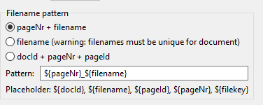
Filename
Under “Filename pattern” you can choose how the filename will be composed.
Note: The second option “filename” is the standard one.
With this option the exported file will have the same name as the document you imported. This is important if you want to match local transcripts with the images in Transkribus.
So if you export a document, then adjust it externally and after that upload it to Transkribus again, the program will need to have two similar filenames in order to recognise the file properly.
www.cdcs.ed.ac.uk

Slide 53
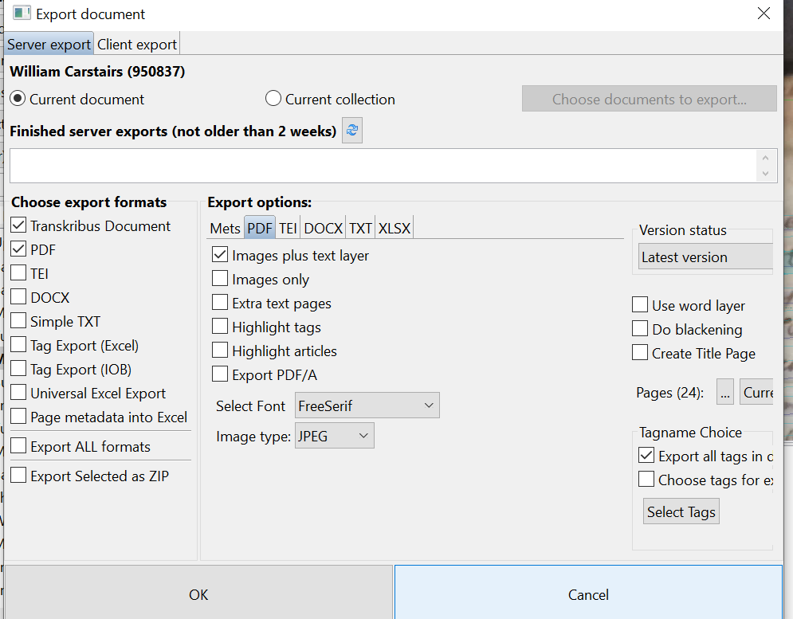
PDF export
If you export a PDF file you can choose between “Images only” or “Images plus text layer” “Images only”: you will produce a PDF file with the document as an image. This means that you will not see the transcribed text.
“Images plus text layer”: you will see two layers in the exported PDF document: OCR (the transcribed text) and image (image of the document).
“Extra text pages”: if you scroll down in the exported PDF file, the transcribed text will appear after the image.
“Highlight tags”: this option will highlight any tags in your transcription. The tags will be shown in the same colours used in Transkribus. At the end of the document there will also be a symbol legend to explain the signification of the different colours.
www.cdcs.ed.ac.uk

Slide 54
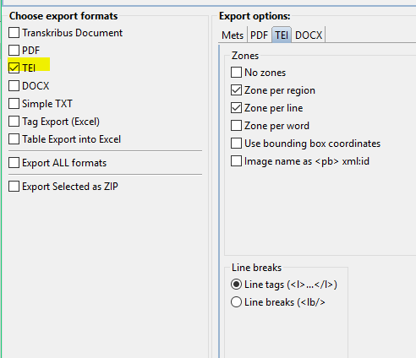
TEI export
This option is for people working with the Text Encoding Initiative (TEI).
Transkribus enables you to choose the zones you need.
Furthermore you can choose between line tags and line breaks.
More information at: http://www.tei-c.org/index.xml
www.cdcs.ed.ac.uk

Slide 55
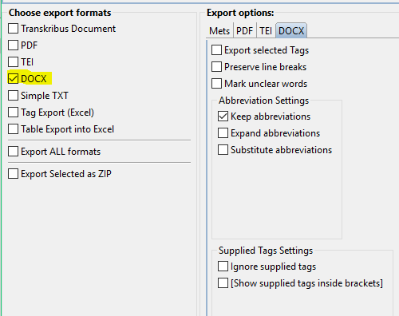
DOCX or TXT export
Export as DOCX
By choosing this option you will get your transcriptions in Word files.
You can select options relating to line breaks, abbreviations and more according to your needs.
Export as simple TXT
If you do not usually work with Microsoft Word it is possible to export your transcription as a simple TXT file.
www.cdcs.ed.ac.uk

Slide 56
Exporting tags
If you would like to export the tags you assigned to your transcription, there are three possible options:
Excel file: select this option to produce an Excel file with individual tabs for each tag category and one tab with an overview of all the tags.
PDF file: select “highlight tags” option to highlight the tags in the exported PDF file.
DOCX file: to highlight tags, follow the step-by-step instructions at: https://readcoop.eu/transkribus/howto/how-to-export-documents-from-transkribus/
www.cdcs.ed.ac.uk

Slide 57
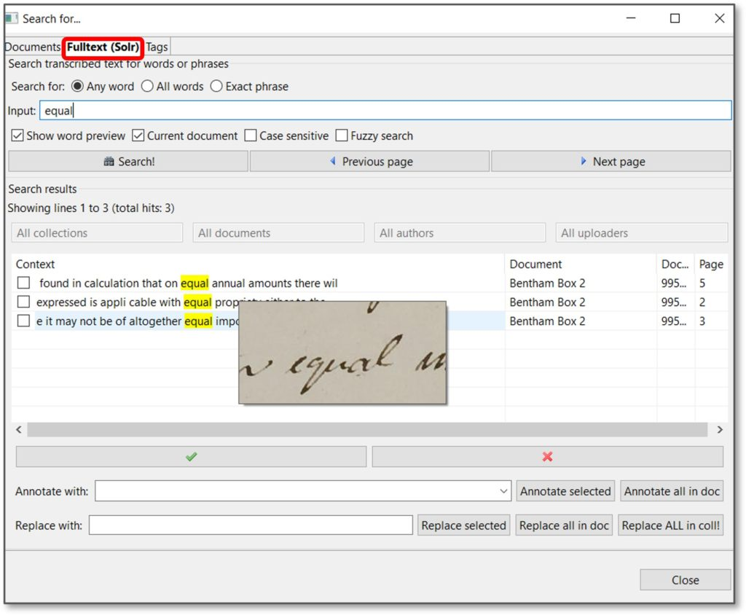

Keyword Spotting
Once you have run the HTR model on your documents, you can search for specific terms.
Open the Search function with the binoculars
In the window which opens up, choose the “Fulltext (Sorl)” tab
Type the word you would like to search and press the “Search!”
The results will appear below: by hovering with the cursor on a result, you will see the word preview; when you double-click on a result, the page containing it will open in the background.
You can also flag the “Fuzzy Search” option: this allows the finding of similar words in addition to exact matches
Useful when alternative spellings are plausible.
www.cdcs.ed.ac.uk

Slide 58
More resources
Thanks for listening today!
Also a dedicated YouTube channel:
https://www.youtube.com/@transkribus
And a community Twitter and Facebook group:
https://twitter.com/Transkribus
https://www.facebook.com/groups/614090738935143/
Many many more resources, instructions and how-to guides available at:
https://readcoop.eu/transkribus/
https://readcoop.eu/transkribus/resources/how-to-guides/
https://help.transkribus.org
www.cdcs.ed.ac.uk

Slide 59
More resources
Feel free to use the Teams chat if you have further questions or queries as you play around with Transkribus
Please take 5 minutes to fill up our Feedback survey which will be emailed to you and posted on the Teams chat https://forms.office.com/r/YYNrqvuNr8
If you want to discover more CDCS Training the list of this semester training is here https://www.cdcs.ed.ac.uk/training
Have a good rest of the week everyone!
That’s all folks!
www.cdcs.ed.ac.uk

Slide 60
Credits
These slides were created using material from the Transkribus website: https://readcoop.eu/transkribus/resources/how-to-guides
Some material was also taken from slides created by Lucia Michielin and Joe Nockels and the author wishes to thank both for their input
Historical photographs used in this course supplied by Blair Atholl Estates, with special thanks to Karen Guthrie (archivist)
www.cdcs.ed.ac.uk

